Slide 1

Goalkeeper Success Rate Simulation
Claire Wu|Salonee Shah|Samuel John
Notes:
http://chesmontsports.com/wp-content/uploads/2015/10/soccer22.jpg

Slide 2
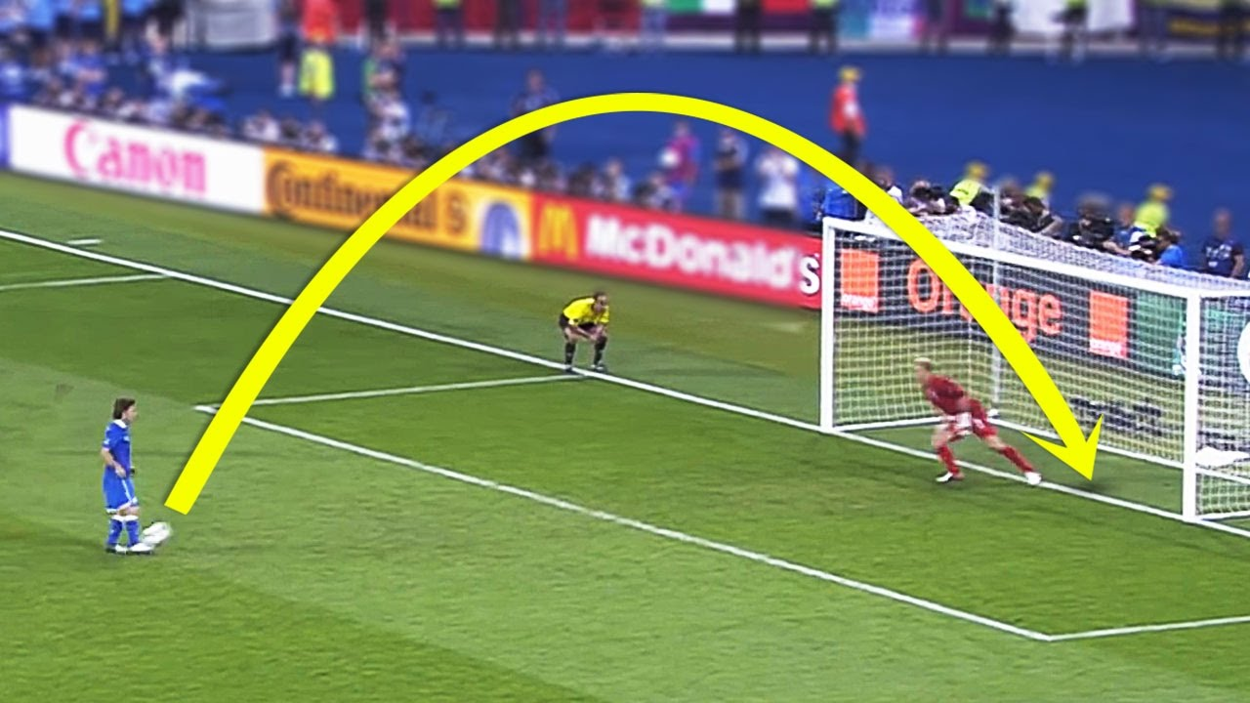
What is Penalty Kick?
Awarded to opponent when a direct kick foul is committed within penalty area
Shot is taken from the Penalty Mark, which is 12 yards from the goal line
Defended only by the opposing team’s goal keeper
https://i.ytimg.com/vi/Rv3v7ZfYp-g/maxresdefault.jpg
https://en.wikipedia.org/wiki/Penalty_shot#Association_football

Slide 3
Objective
Scenario
Goalie jumps in a random direction
Simulate the success percentage of a goalkeeper
Goalie jumps in the direction of the opponent Team’s most frequent shoot direction
Check if using strategies can improve the goalkeeper’s success rate or not
Goalie jumps in the direction of each opponent’s(player) most frequent shoot direction

Slide 4
Hypothesis & Assumptions
Hypothesis:
Saving the ball based on team’s most frequent kicking direction/each striker’s most frequent kicking direction can increase the success percentage of a goalie
Assumption:
If goalie's direction is the same as striker's direction, the goalie wins
Striker has 9 kicking directions and Goalie has 9 saving directions
Striker’s kicking direction will not be changed based on Goalie’s behavior(In Scenario 2&3, If Goalie found a team’s or a player’s frequent direction, and always save the ball in that direction, striker’s kick will not be affected or changed)

Slide 5
Process
1) Work on Hypothesis and Assumptions
2) Determine Variables/Scenarios
(Variables: striker kick direction, goalie save direction, etc.)
3) Use Monte Carlo to realize the Simulation for Three Scenarios
Scenario 1 √
Scenario 2 √
Scenario 3 To be done soon

Slide 6
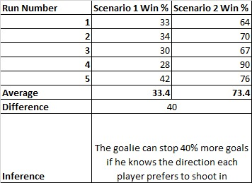
Result for Scenario 1&2- need update for 9 direction version

Slide 7
Limitations
Future Work
Randomly simulate striker’s moves instead of using a large real dataset
Historic moves may not be a true representation of future striker’s move
Striker’s kicking direction is randomly simulated, but strikers may change their striking strategy based on Goalie’s past behavior
In the future, we can consider two another scenarios:
1) Goalie jumps based on team/player tendency, including striker kick speed and goalie reaction time
2) Create two teams, run a penalty shootout scenario and select winning team

Slide 8
Thank You!

